Slide 1
Food Vision AI: Deep Learning for Food Classification
Capstone Project
Presented By: Hammad Latif

Slide 2
Table of contents
02
01
Project Overview
Methodology
Key Results
05
06
07
User Interface
Future Enhancements
03
Challenges
08
09
Summary
Questions

Slide 3
Project Overview​

Slide 4
Problem statement
Challenge
Accurate food image classification is complex due to diversity, lighting, and overlapping visual characteristics.
Relevance: Applications in health monitoring, e-commerce, and restaurant management.

Slide 5
Objective
1
Develop a deep learning model to classify food images into 101 categories using the Food101 dataset.
2
Ensure practical usability via a deployed web application.

Slide 6
Methodology Overview​

Slide 7
Methodology
1
Dataset Preparation: Resized images to 224x224 pixels, split dataset for training/validation/testing.
Model Architecture: Used pre-trained EfficientNetB7, added GlobalAveragePooling and dense layers.
2
Training: Mixed precision training; fine-tuned with adaptive learning rates.
3
Deployment: Flask-based web app for real-world use.
4

Slide 8
Key Results

Slide 9
Results
Accuracy: Achieved 83.35% on test data, outperforming benchmarks.
Deployment Success: Functional and user-friendly web interface.
Generalizability: Worked well on custom internet-sourced images.

Slide 10
Challenges
Overfitting despite optimization efforts.
Resource and time constraints on Colab.
Training interruptions (e.g., WiFi outages).

Slide 11
Limitations
Struggled with visually similar classes like apple pie, ravioli, and pork chop.
Overfitting observed in training vs. validation accuracy trends.

Slide 12
User Interface

Slide 13
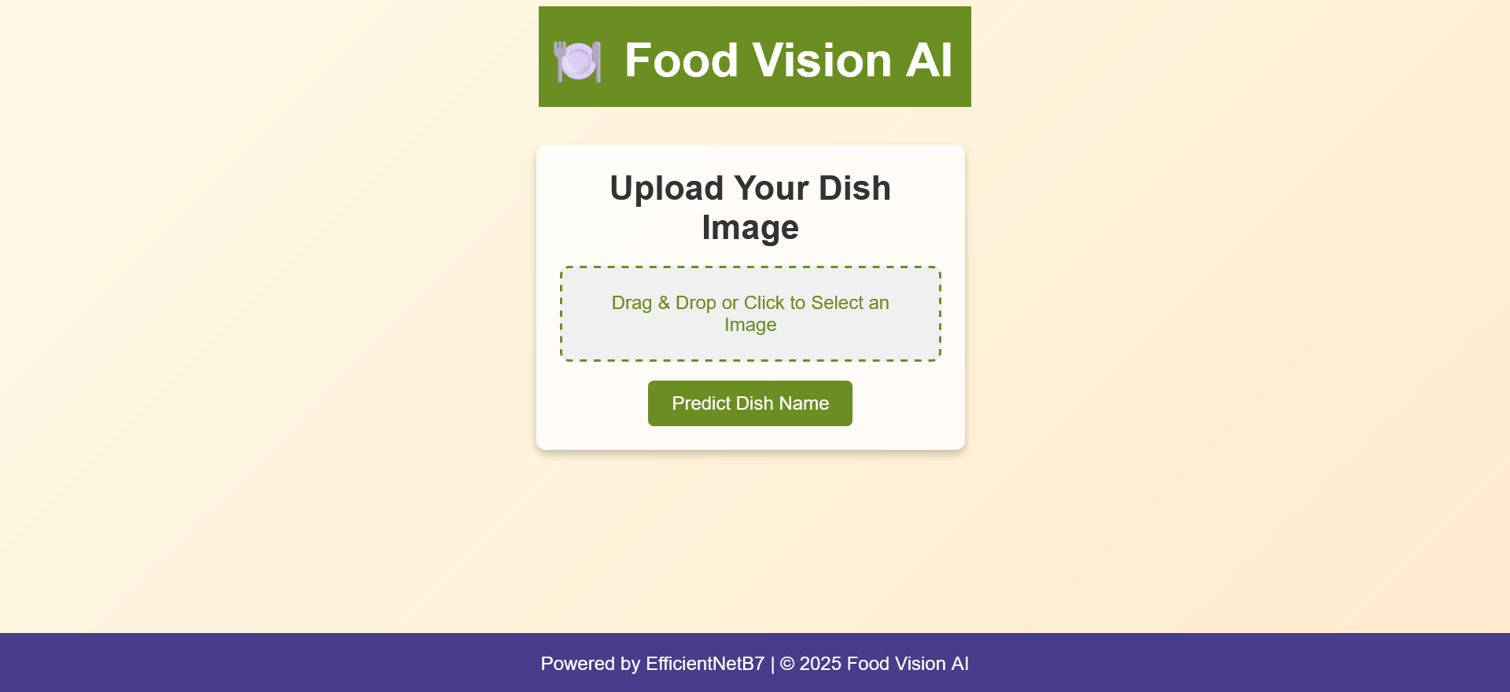

Slide 14
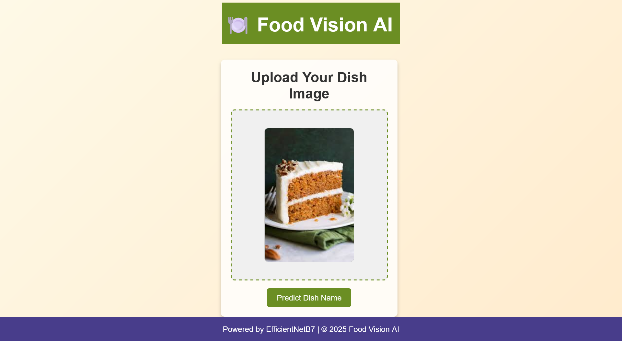

Slide 15
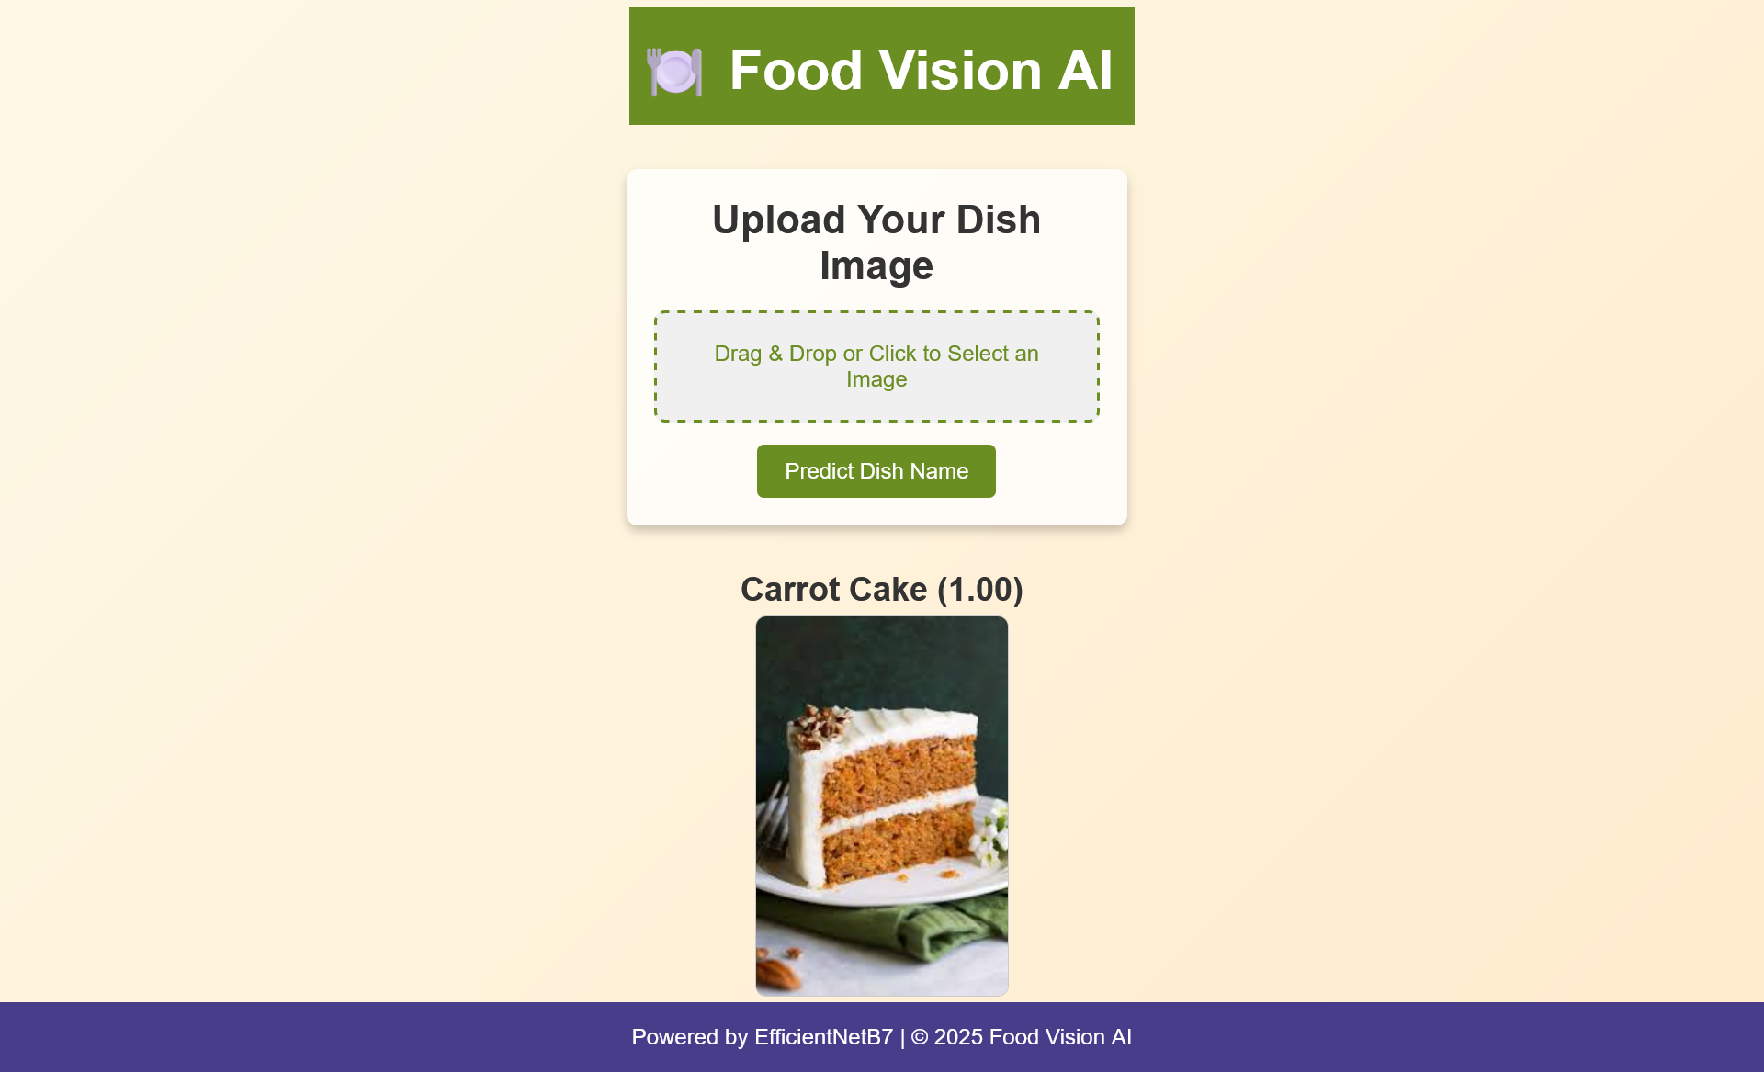

Slide 16
Future Enhancement

Slide 17
Future Enhancements
Address overfitting with techniques like data augmentation and regularization.
Improve cultural inclusivity in food classification.
Optimize for real-time predictions and broader deployment (e.g., mobile apps).
Integrate nutritional information for added value.

Slide 18
Summary

Slide 19
Conclusion
Food Vision AI demonstrates the potential of leveraging EfficientNetB7 for complex classification tasks.
Practical deployment achieved, setting the stage for further refinements.

Slide 20
Any Questions?

